Slide 1
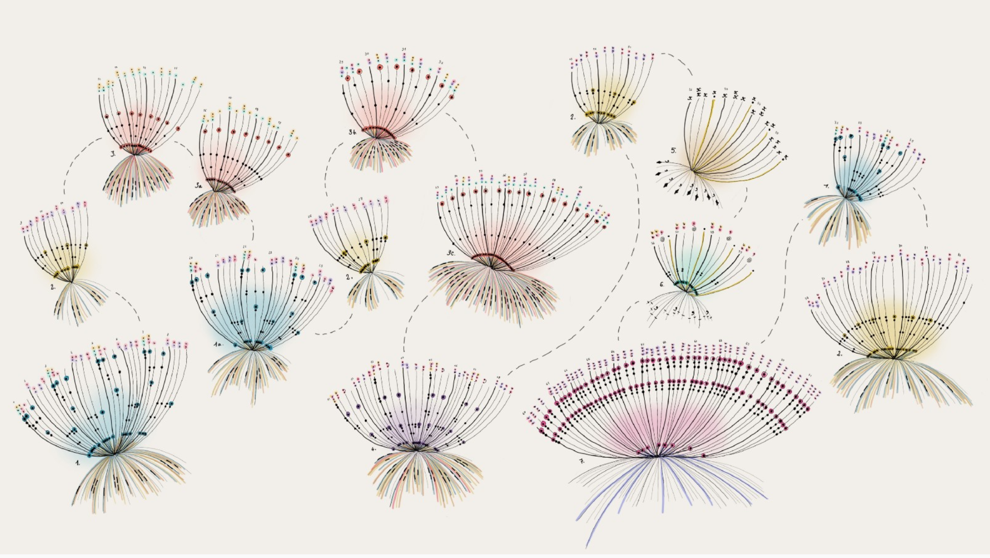
Giorgia Lupi
“I do see a place where, ultimately, instead of using data to become more efficient, we will all use data to become more humane”

Slide 2
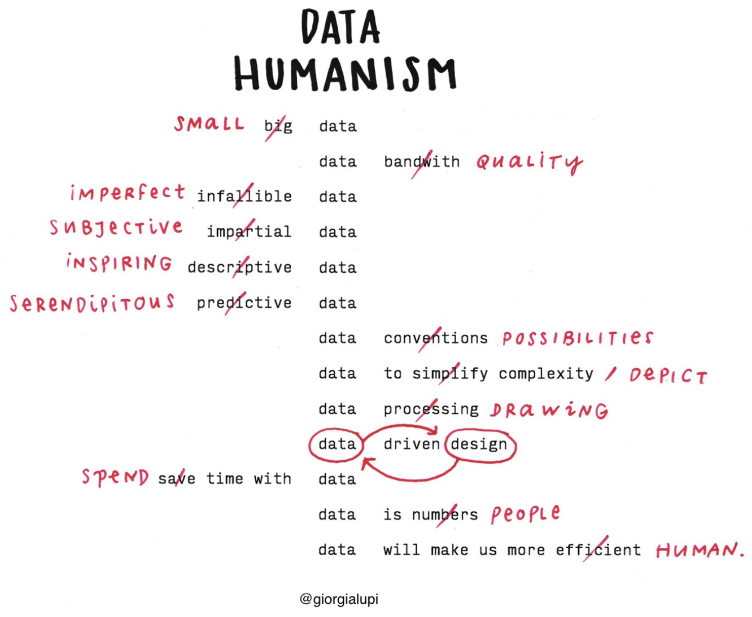

Slide 3
Accurat
MoMa
Founder
Dear Data
Accurat, founded by Lupi in 2011 - is a data-driven design firm with offices in Milan and New York. She’s the creative director.
Her work was acquired by the MoMa and is part of the permanent collection.
About
Giorgia
MIT
PhD
MIT Media Lab
Politecnico di Milano
Director’s Fellow
She has a Master’s in Architecture and a PhD in design.
Notes:
http://directorsfellows.media.mit.edu/fellow-profiles/giorgia-lupi/

Slide 4
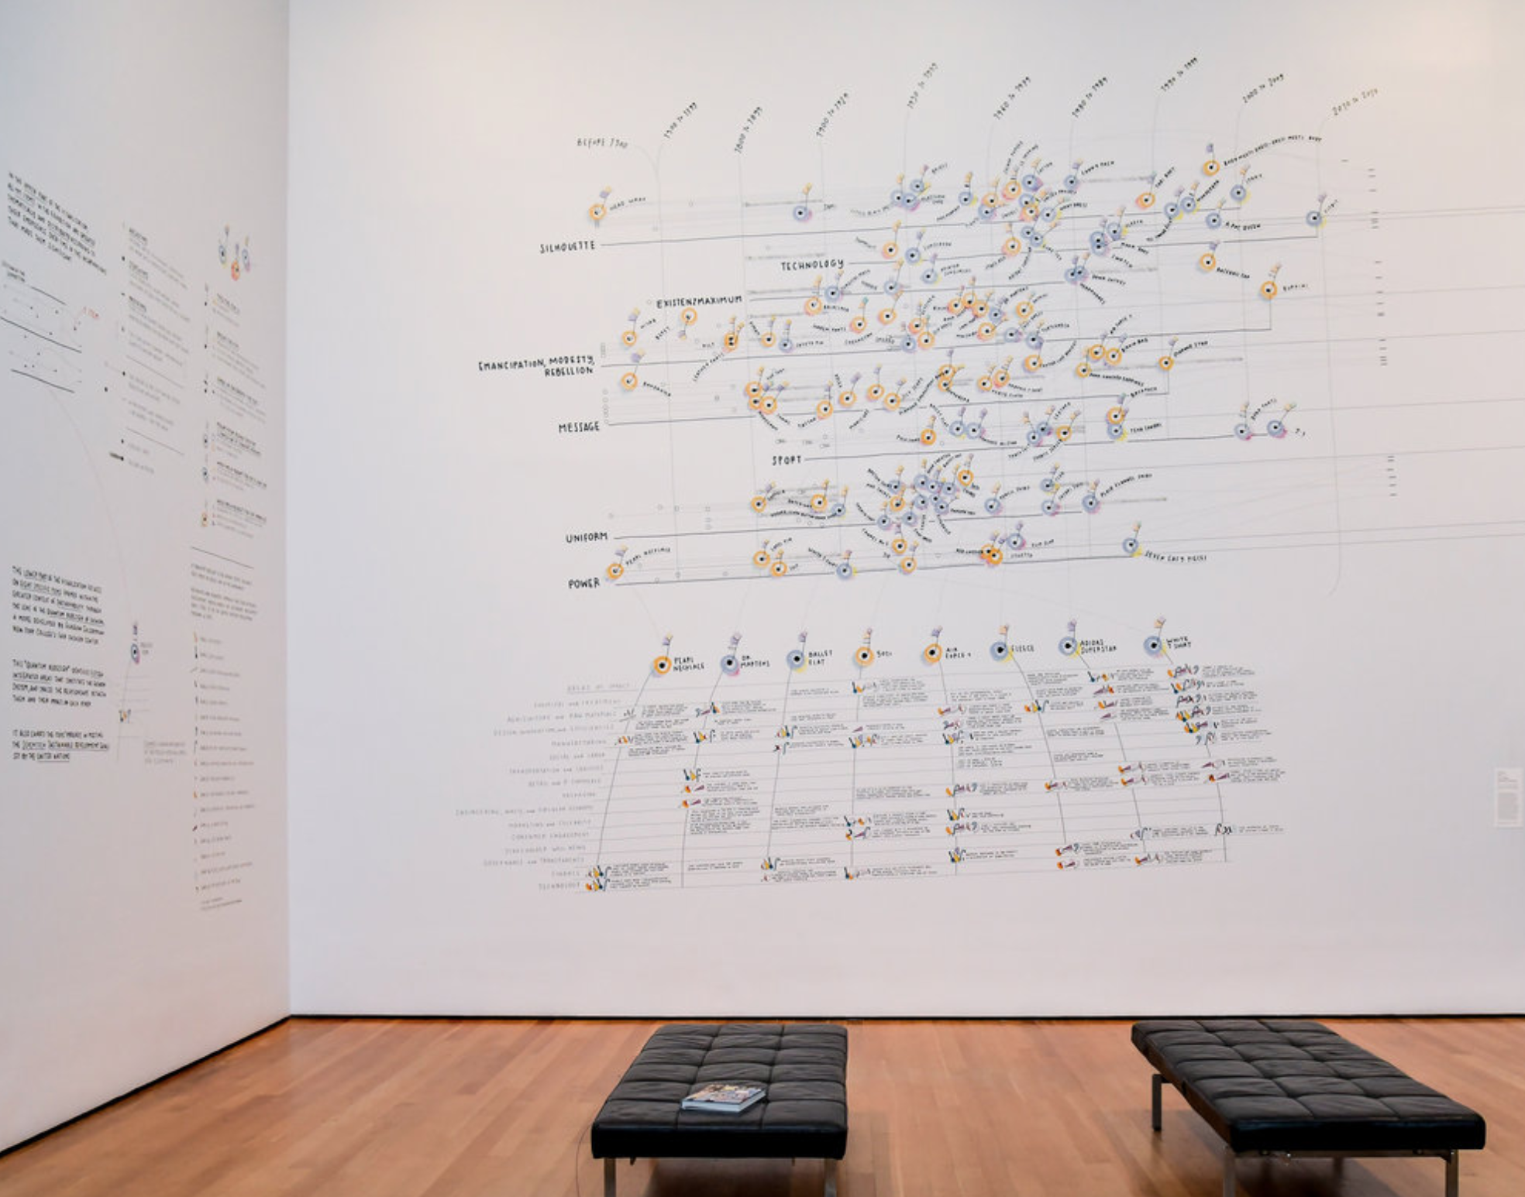
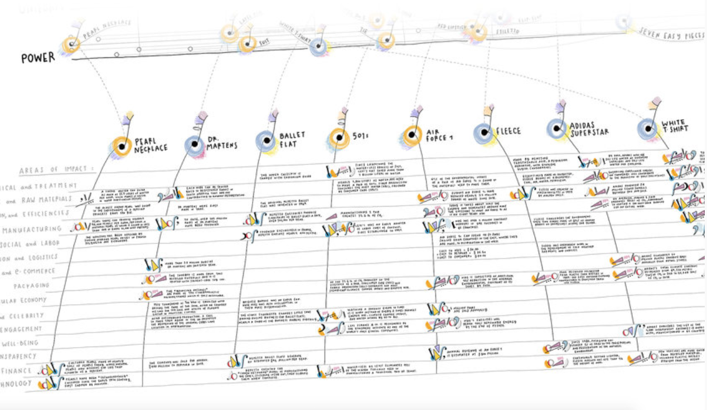
Items: Is Fashion Modern?
Museum of Modern Art
-
What the viz displays
-
Represents 111 items
-
Displayed from Oct to Jan 2018
This viz envisions the prominent role fashion plays as a connecting tissue between people and cultures
This exhibit explored the present, past and future of the items of clothing & accessories that have had a strong impact on the world
Displayed at the end of the exhibit

Slide 5
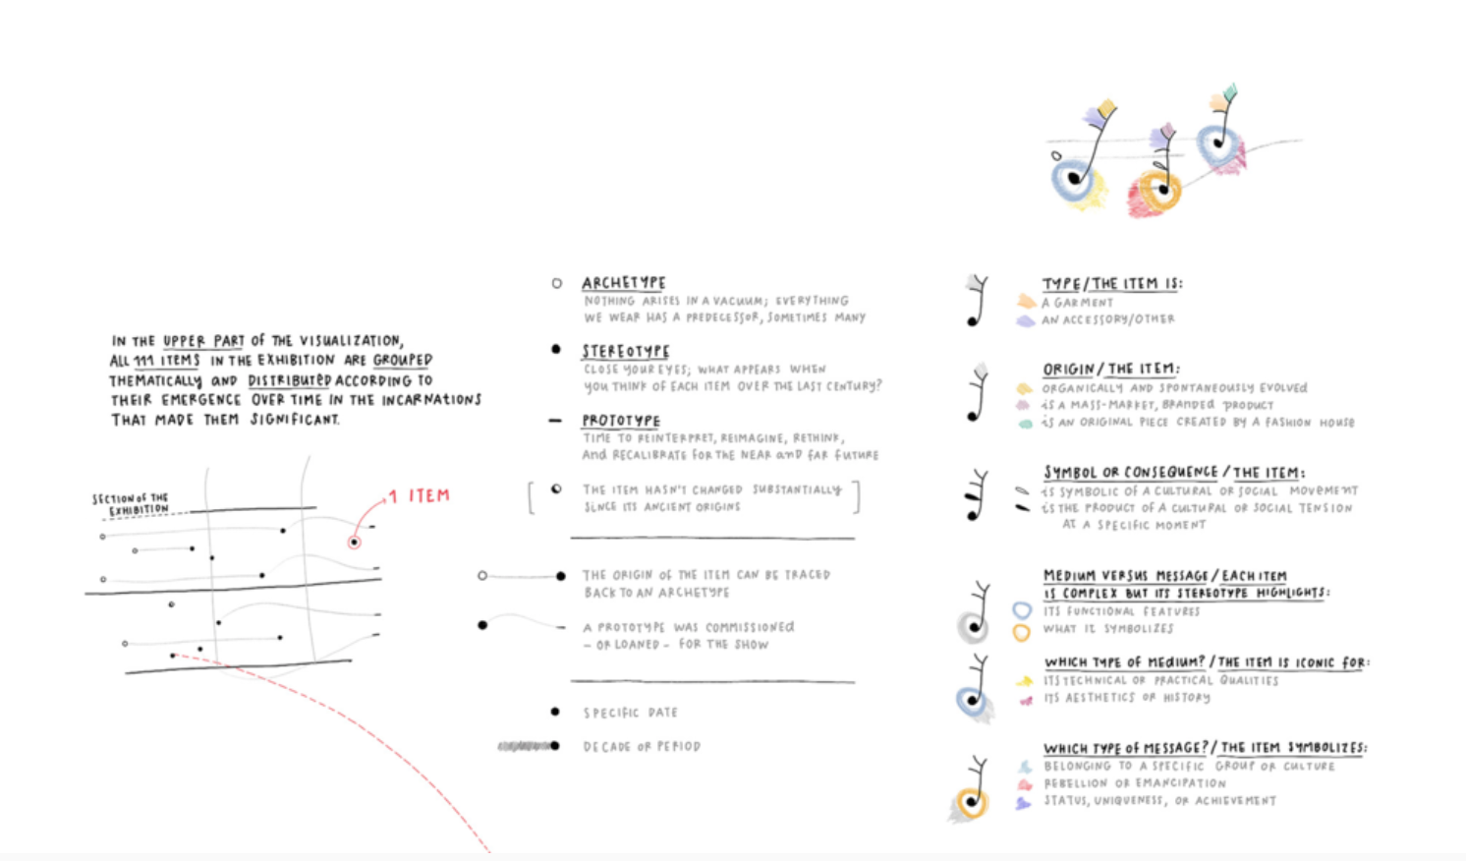
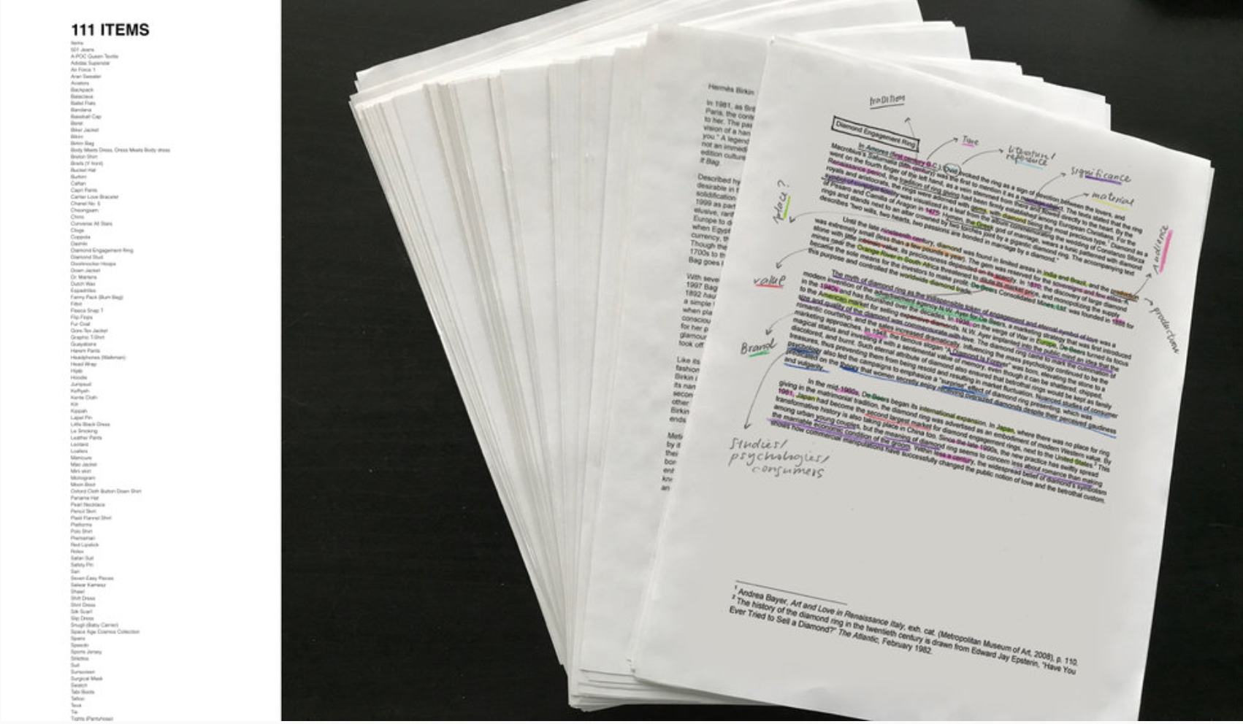
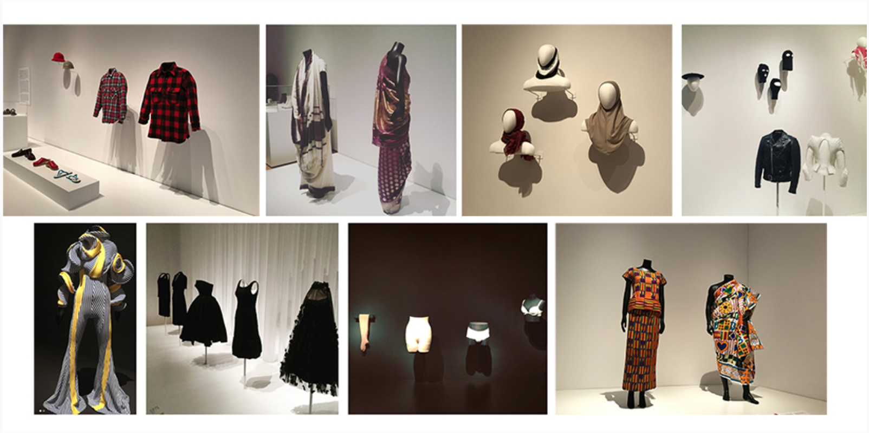
Items: Is Fashion Modern?
Design Process/Details
Legend of Viz
Preliminary research on 111 items
Items found in the exhibit
Notes:
Hi res version: https://www.dropbox.com/s/bs0ktmvlr2z1mqo/MoMA-ITEMS%20-%20Giorgia%20Lupi.jpg?dl=0

Slide 6
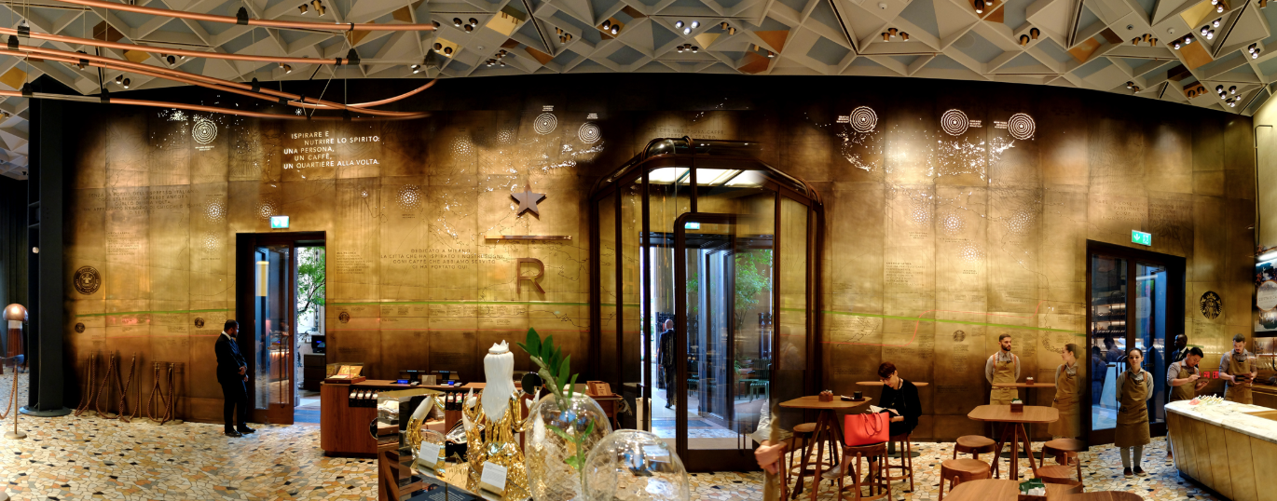
Data Wall Experience
Starbucks Reserve
-
Starbucks Experience in AR
-
Digital Layer
-
Homage to Coffee Culture
Accurat designed the centerpiece wall of the store to commemorate first store in Milan
Users can access more info from engraved brass wall on AR app.
Designed as an homage to the Italian espresso culture that inspired Howard Schultz 35 years ago.

Slide 7
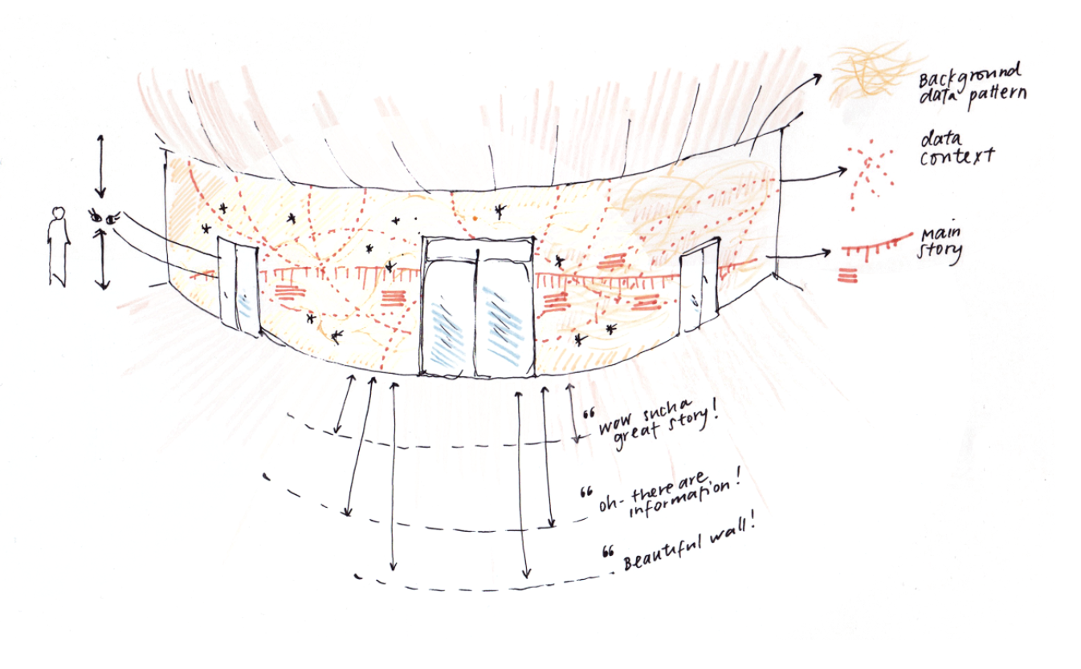
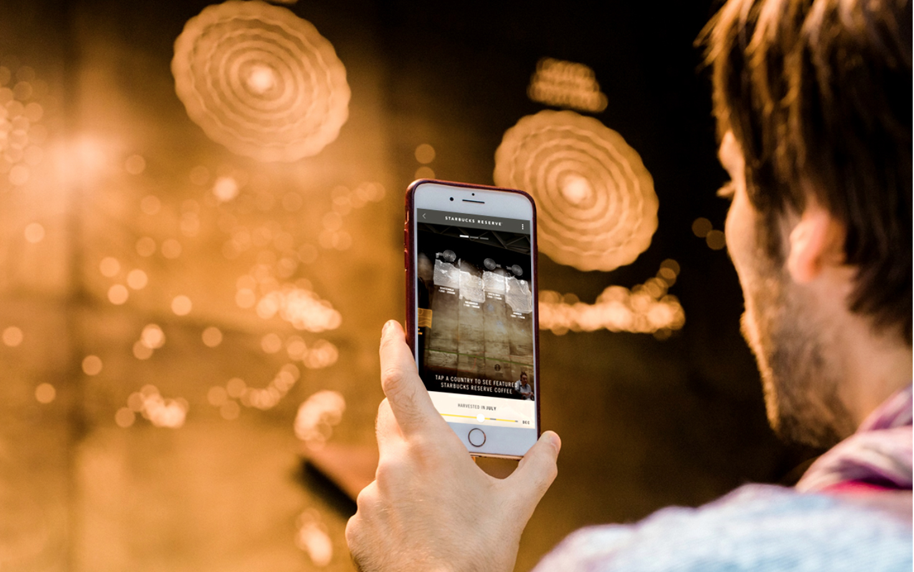
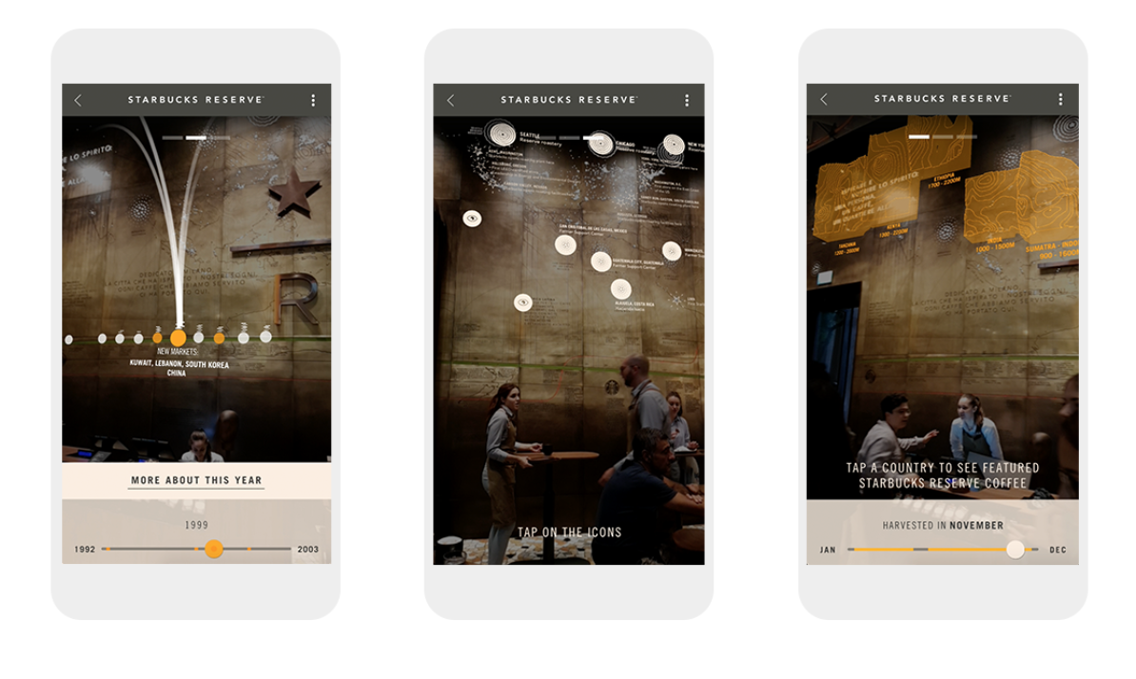
Data Wall Experience
Design Process/Details
Giorgia’s sketch of initial design
AR app accompanying wall
User accessing more information about Starbucks from AR app.
Notes:
Hi res version:

Slide 8
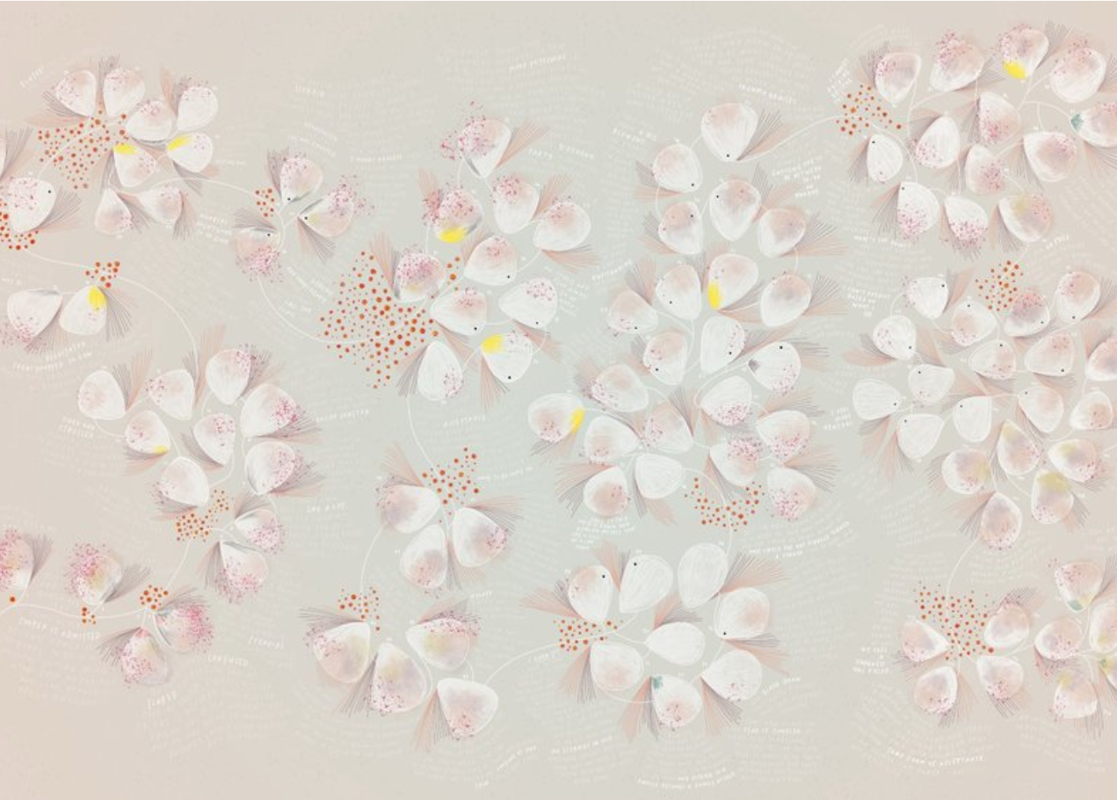
Bruises: The Data We Don’t See
Collaboration with Kaki
-
Collaboration between Kaki and Giorgia
Visualizing Kaki’s daughter’s autoimmune disorder through daily observations.
-
Musical Score Accompanies Viz
Kaki wrote a song that accompanies the viz.
-
Visual Process
Innovative way to visualize nuances of having a chronic illness.

Slide 9
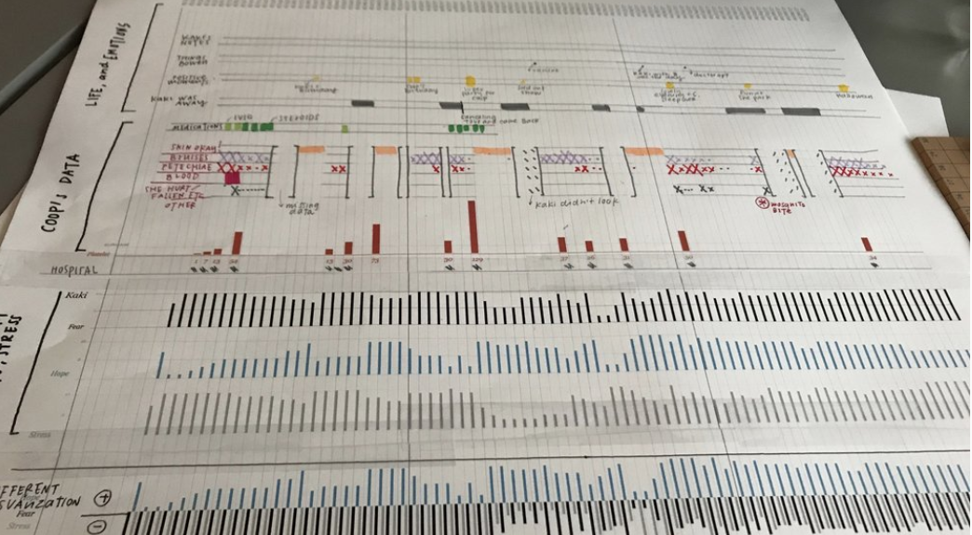
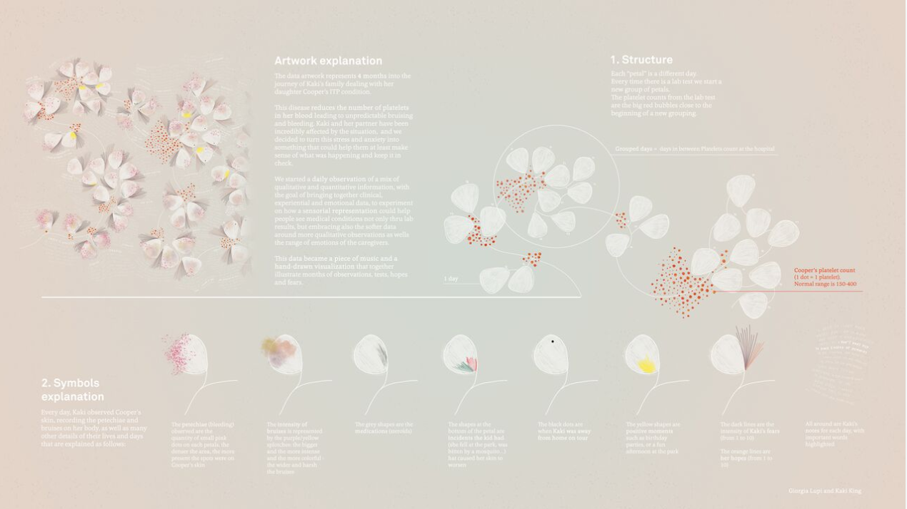
Bruises: The Data We Don’t See (link)
Design Process/Details
Giorgia and Kaki’s daily observation of Cooper’s condition.
Legend
Notes:
Hi res version:

Slide 10
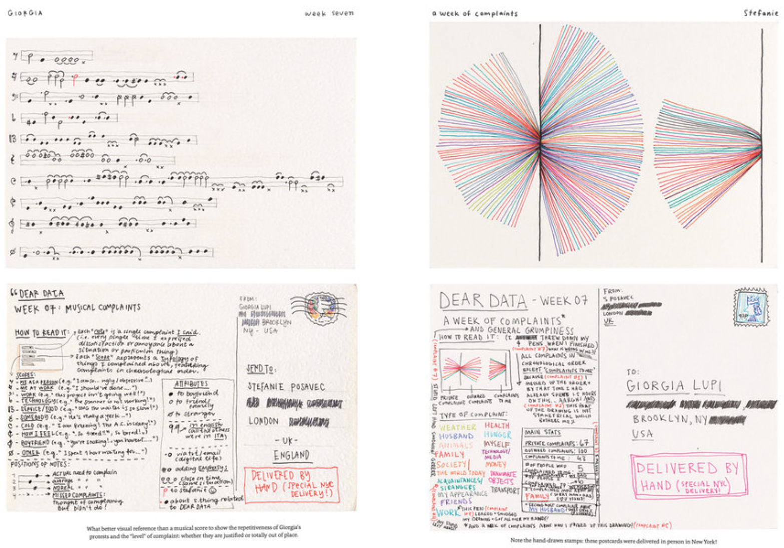
Dear Data
Museum of Modern Art
-
Year Long Data Project
Giorgia and Stefanie sent each other 52 hand drawn data postcards between New York and London
-
Slow Data Transmission
Analog data transmission – using the mailbox as the transmitter – receiving data slowly vs asap.
-
Visualizing the Mundane
Visualizing the mundane helped each other discover key insights about the other person. Visualizing imperfection.

Slide 11
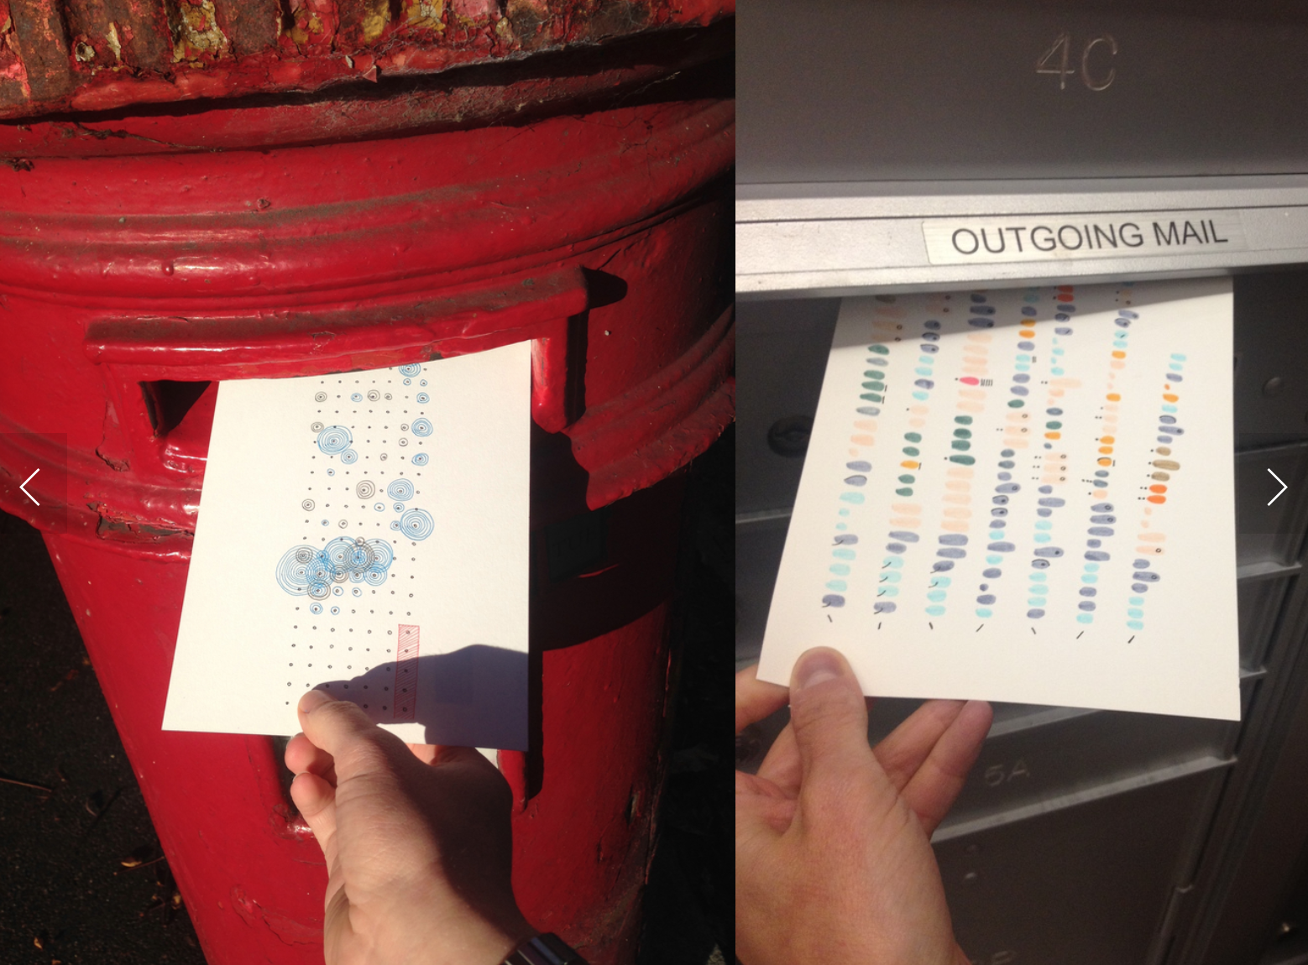
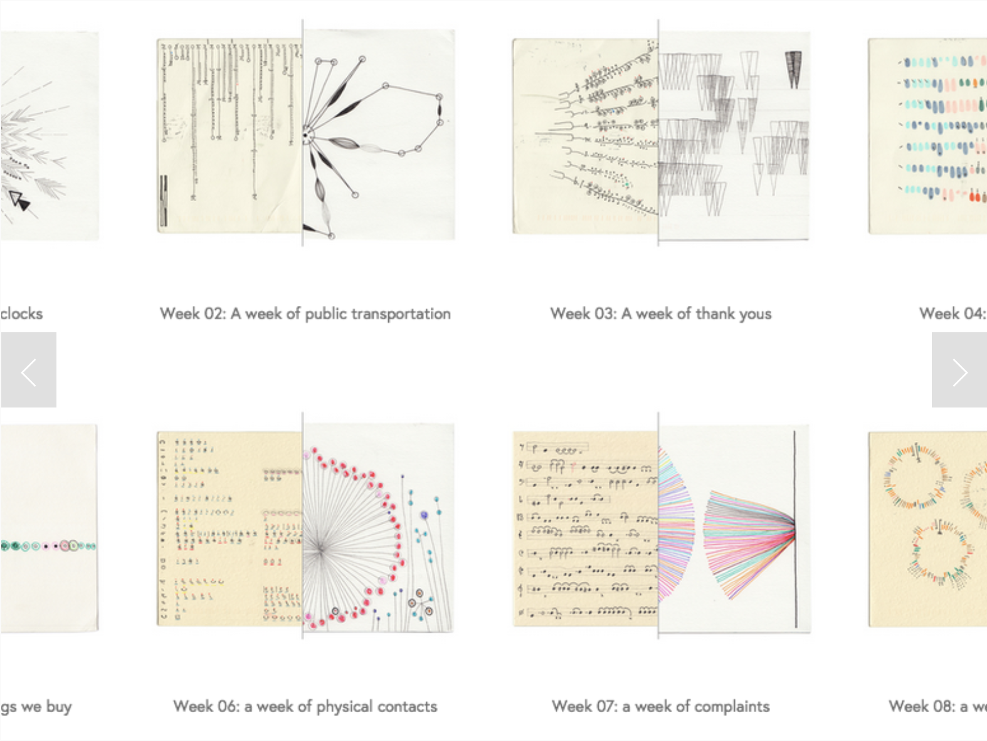
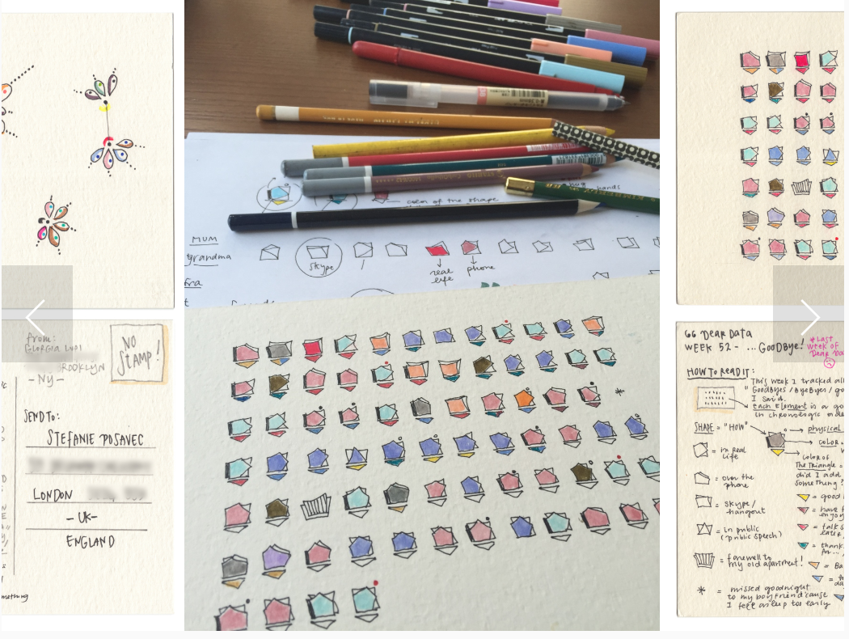
Dear Data (link)
Design Process/Details
Slow Data Transmission
A look at the themes for different weeks
Example of design process that went into creating a postcard
Notes:
Hi res version:

Slide 12
Giorgia Lupi’s Design Process/Output: Pros & Cons
Pros
Cons
Applying empathy & humanism to data
Creative and relatable approach to data visualization
Open design process (initial sketches)
Driving personal insights that we may not be aware of
Uses colours skillfully
Using a medium other than a digitally made rendition
Difficult to apply insights to large population (can’t make generalizations)
Her visualizations may present accessibility issues (colours are not always accessible, intricate designs)
Legends are very detailed and take a lot of time to interpret

Slide 13
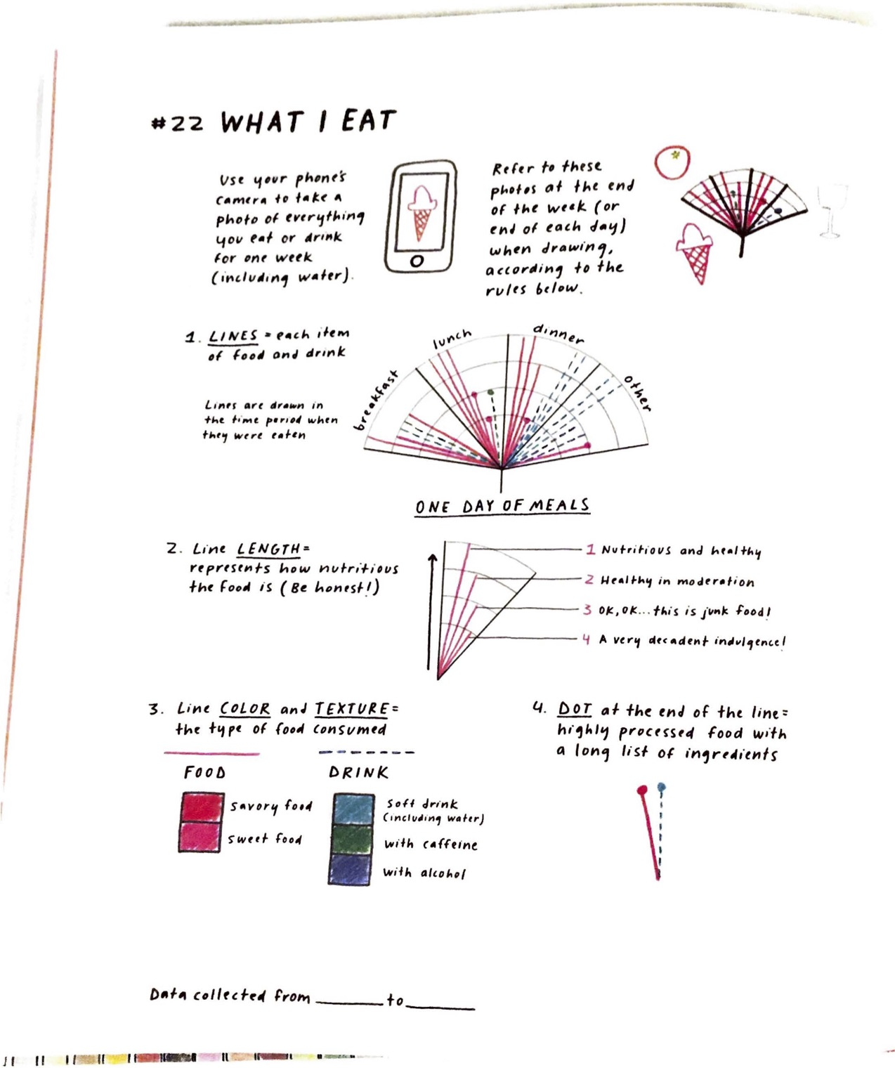
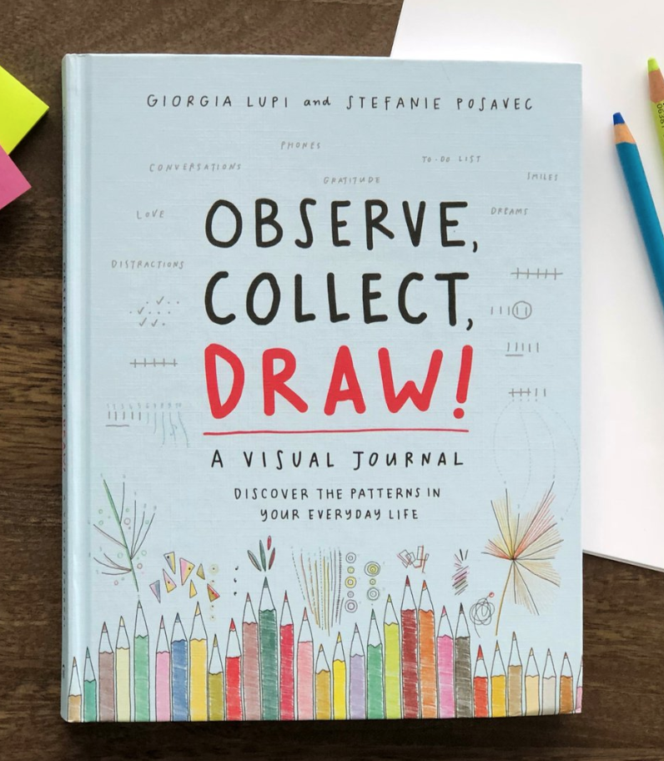
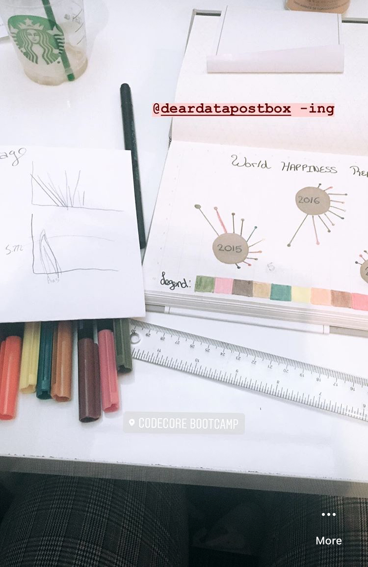
Dear
Diary
Activity

Slide 14
Discussion
What was the process of drawing personal data like for you?
What are your responses to Data Humanism?
How can you apply her visualizations to concepts we’ve learned in class?
Does drawing data visualizations hinder or add another dimension to the data visualization field?

Slide 15
Sources
www.giorgialupi.com
www.accurat.it
www.moma.org

Slide 16
THE END

